Slide 1
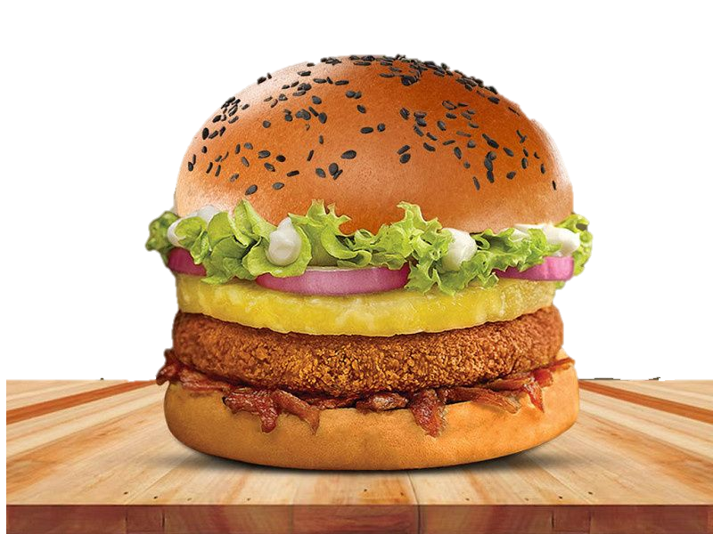

Slide 2
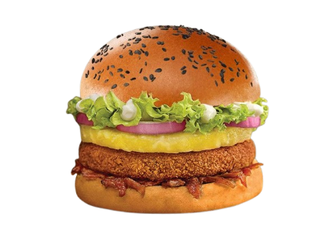
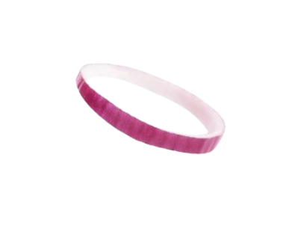
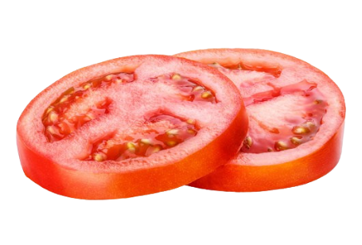
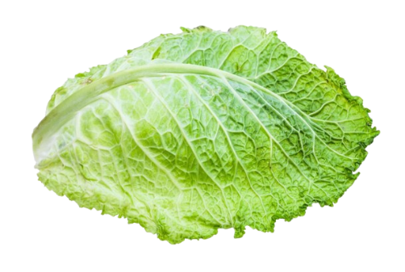
HERE
WE
HAVE
SOMETHING
YUMMY
AND
FRESH
YUMMMY
FOR YOU

Slide 3
YUMMY
FRESH
AND

Slide 4
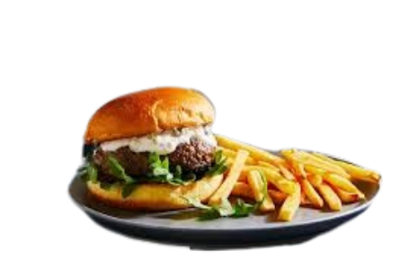
ARE YOU HUNGRY ?
THAN DO VISIT
RIYA’S CAFE

